Slide 1

Analysis of Telecom Services: Customer Churn and Satisfaction Nivinraj.K Batch: MB25

Slide 2
Agenda of the analysis:
Introduction
Data overview
Churn analysis
Key insights
Final thoughts

Slide 3
Introduction:
Objective:
To analyze customer churn and satisfaction within the telecom industry, identifying key drivers and patterns to inform strategic decisions.
Scope:
Churn analysis based on categories and reasons.
Customer satisfaction trends.
Data-driven insights and actionable recommendations.

Slide 4
Data Overview:
Data Source:
This data source contains the following:
Customer service records
Satisfaction surveys
Churn reports
Data Structure:
The data is structured by containing the following categories called Customer ID, gender, age, married, Number of Dependents, City, Zip Code, Latitude, Longitude, Number of Referrals, Tenure in Months, Offer Phone_Service, Avg_Monthly_Long_Distance_Charges, Multiple_Lines, Internet_Service, Internet_Type, Avg_Monthly_GB_Download, Online_Security, Online_Backup, Device_Protection_Plan Premium_Tech_Support, Streaming_TV, Streaming_Movies, Streaming_Music, Unlimited_Data, Contract, Paperless_Billing ,Payment_Method, Monthly_Charge, Total_Charges, Total_Refunds, Total_Extra_Data_Charges, Total_Long_Distance_Charges, Total_Revenue Customer_Status, Churn_Category, Churn_Reason.

Slide 5
Churn Analysis:
Churn Definition: Churn refers to customers who have discontinued their service within a given period.
Analysis focus:
This analysis is to categorize the customer who are churned from the services and to identify at-risk customers and proactively implement retention strategies in future.
Churn rate by categories:
The Churn are categorized as : 1. Due to Competitor
2. Due to dissatisfaction
3. Due to attitude
4. Due to price
5. Due to others

Slide 6
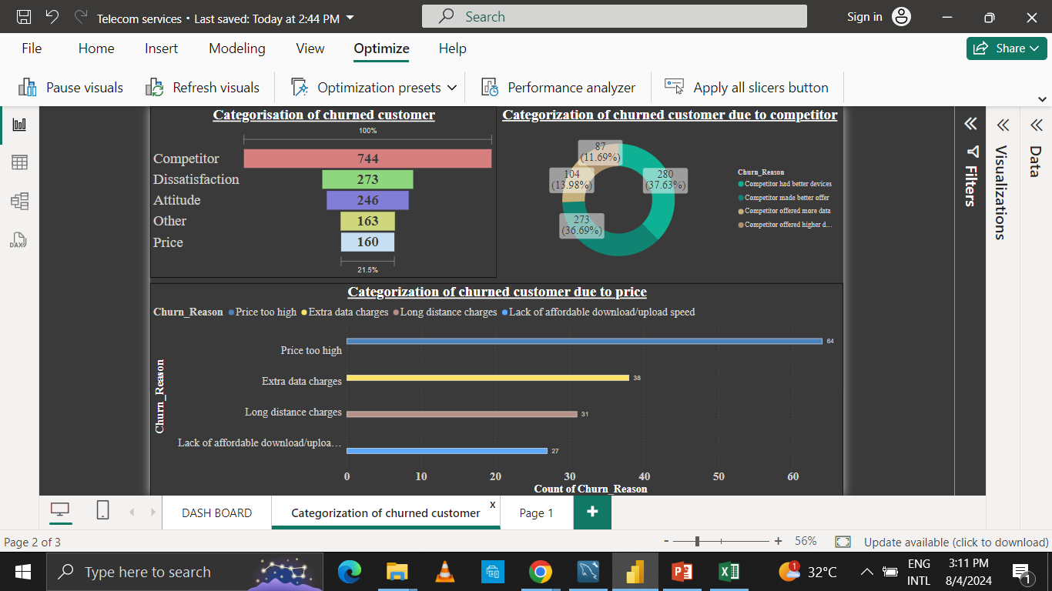

Slide 8
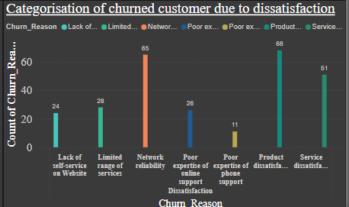

Slide 10
Report on analysis :
From this analysis, it is clear that customer churned from our services is maximum due to the competitor by having better devices and providing better offers.
Followed by the category competitor, customer are churned due to dissatisfaction from our product and its services;
Our customer are churned equally on comparing with the churn rate of dissatisfaction .
Both the reason called others and price for the churn rate stands equally which shows that it affects the growth slightly on comparing to all others;

Slide 11
Key insights:
Based on the analysis there are some key insights in which it is categorized as internal reforms and external reforms for the company.
External Reform:
-- The company should come up with new offers and upgraded devices to provide better services which customer expects. This prevents the customer from churn and retain the existing customers.
-- The better offers and upgraded devices may also results in increasing new customers.
Internal Reforms:
-- The company faces maximum churn due to dissatisfaction from the service we provide and due to the attitude of support person and service provider
-- It is clear that the company should create a new ideas to satisfy the customers through service.
-- Internal reforms in management should be taken to treat the customers in a right way and provide services smoothly.
-- The company should concentrate on fixing of prices by which it gains profit and compete in the market with the competitor.

Slide 12
Final thoughts:
By uncovering these key insights, we’ve unlocked a roadmap to customer retention. Let’s harness their power to optimize more revenue by reducing the churn rate and attracting the new customers in the future.

Slide 13


